Slide 1

Introduction to Deep Learning
What is a
Neural Network?
deeplearning.ai

Slide 2
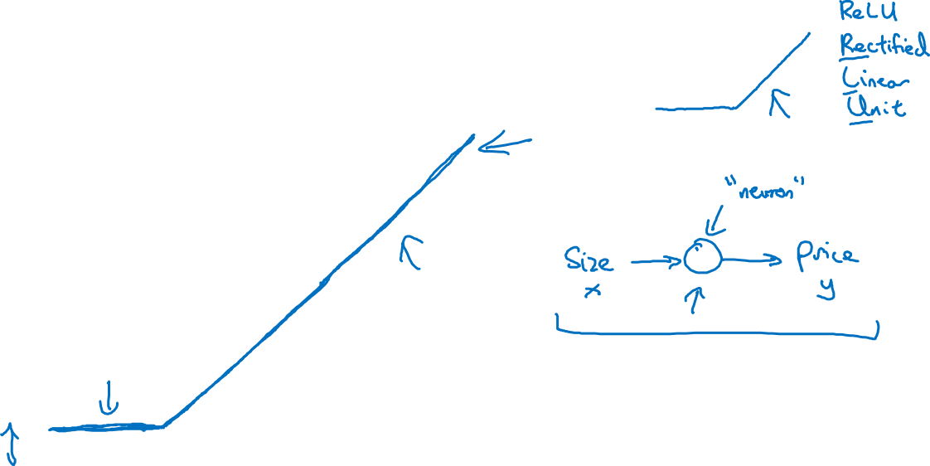
Housing Price Prediction
price
size of house

Slide 3
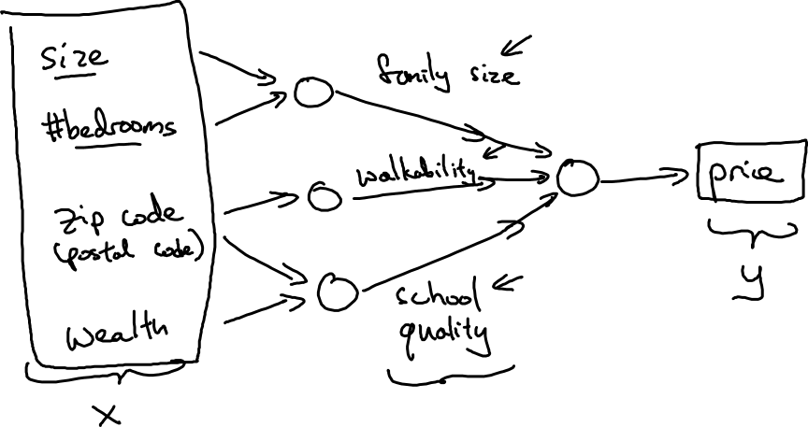
Housing Price Prediction

Slide 4

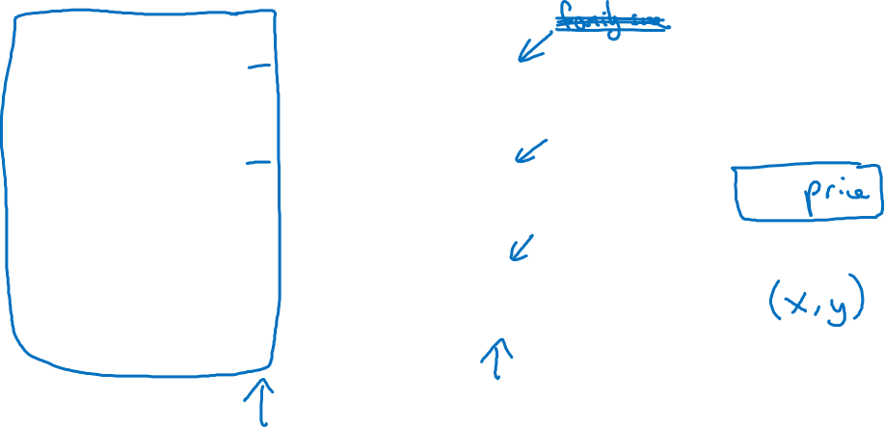
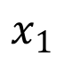
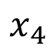
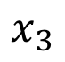
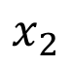
Housing Price Prediction
size
$$x_{1}$$
#bedrooms
$$x_{2}$$
y
zip code
$$x_{3}$$
wealth
$$x_{4}$$

Slide 5
What is neural network?(Supplemental Notes)
It is a powerful learning algorithm inspired by how the brain works.
Example 1 – single neural network
…
Example 2 – Multiple neural network
…
See more in Supplemental Notes.

Slide 6
Introduction to Deep Learning
Supervised Learning
with Neural Networks
deeplearning.ai

Slide 7
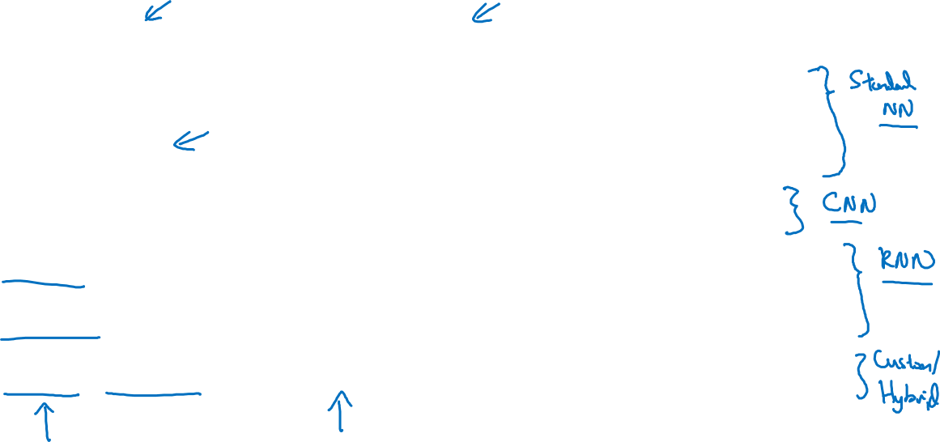
Supervised Learning
Input(x)
Output (y)
Application
Home features
Price
Real Estate
Ad, user info
Click on ad? (0/1)
Online Advertising
Image
Object (1,…,1000)
Photo tagging
Audio
Text transcript
Speech recognition
English
Chinese
Machine translation
Image, Radar info
Position of other cars
Autonomous driving

Slide 8
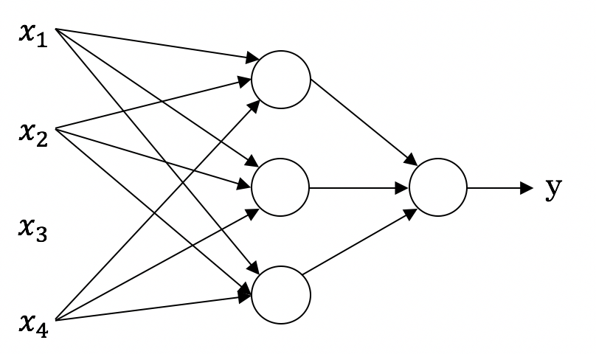
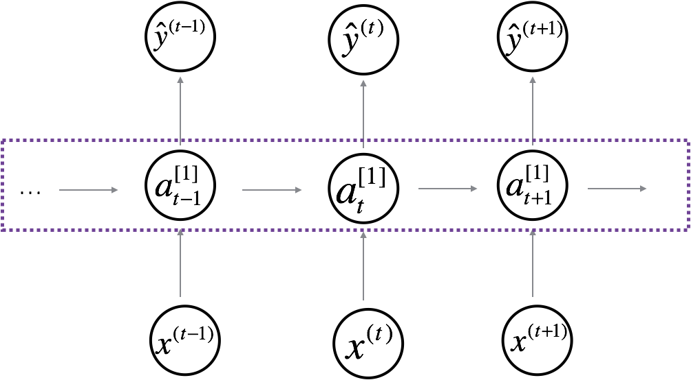
Neural Network examples
Standard NN
Convolutional NN
Recurrent NN

Slide 9
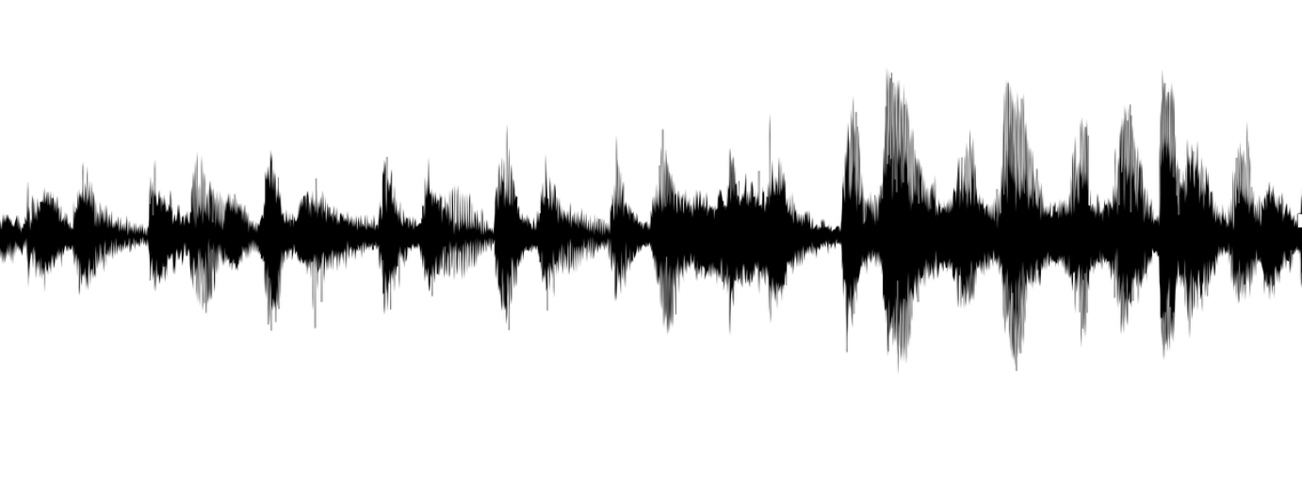


Supervised Learning
Structured Data
Unstructured Data
Size | #bedrooms | … | Price (1000$s)
2104 1600 2400 ⋮ 3000 | 3 3 3 ⋮ 4 |  | 400 330 369 ⋮ 540
Audio
Image
User Age | Ad Id | … | Click
41 80 18 ⋮ 27 | 93242 93287 87312 ⋮ 71244 |  | 1 0 1 ⋮ 1
Four scores and seven years ago…
Text

Slide 10
Supervised learning for Neural Network (Supplemental Notes)
In supervised learning, we are given a data set and already know what our correct output should look like, having the idea that there is a relationship between the input and the output.
Supervised learning problems are categorized into "regression" and "classification" problems. In a regression problem, we are trying to predict results within a continuous output, meaning that we are trying to map input variables to some continuous function. In a classification problem, we are instead trying to predict results in a discrete output. In other words, we are trying to map input variables into discrete categories.
…
See more in Supplemental Notes.

Slide 11
Introduction to Neural Networks
Why is Deep Learning taking off?
deeplearning.ai

Slide 12
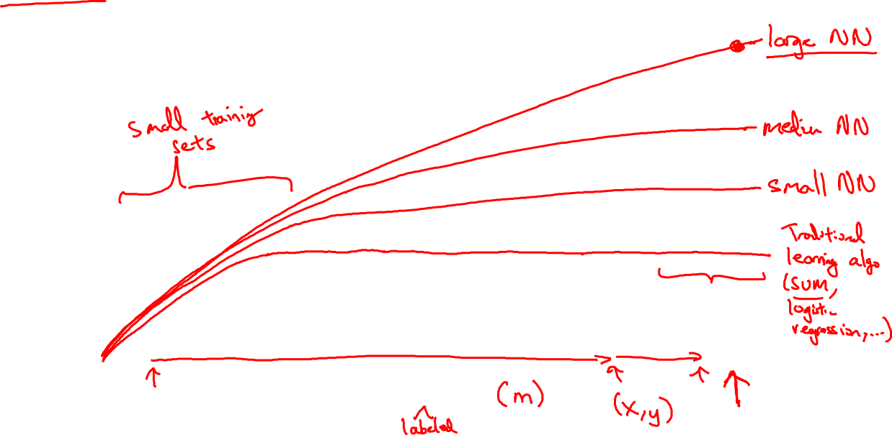
Scale drives deep learning progress
Performance
Amount of data

Slide 13

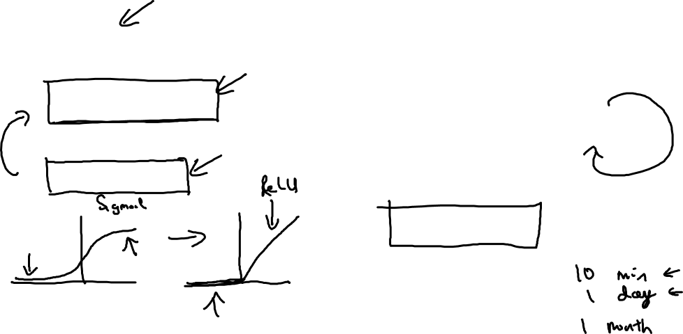
Scale drives deep learning progress
Idea
Data
Computation
Algorithms
Experiment
Code

Slide 14
Why is deep learning taking off? (Supplemental Notes)
Deep learning is taking off due to a large amount of data available through the digitization of the society, faster computation and innovation in the development of neural network algorithm.
Two things have to be considered to get to the high level of performance:
1. Being able to train a big enough neural network
2. Huge amount of labeled data
…
See more in Supplemental Notes.

